Slide 1
Analysis and Design of Algorithms
Session-18
Single-Source Shortest path Problem
Prepared by
Srihari Babu. G

Slide 2
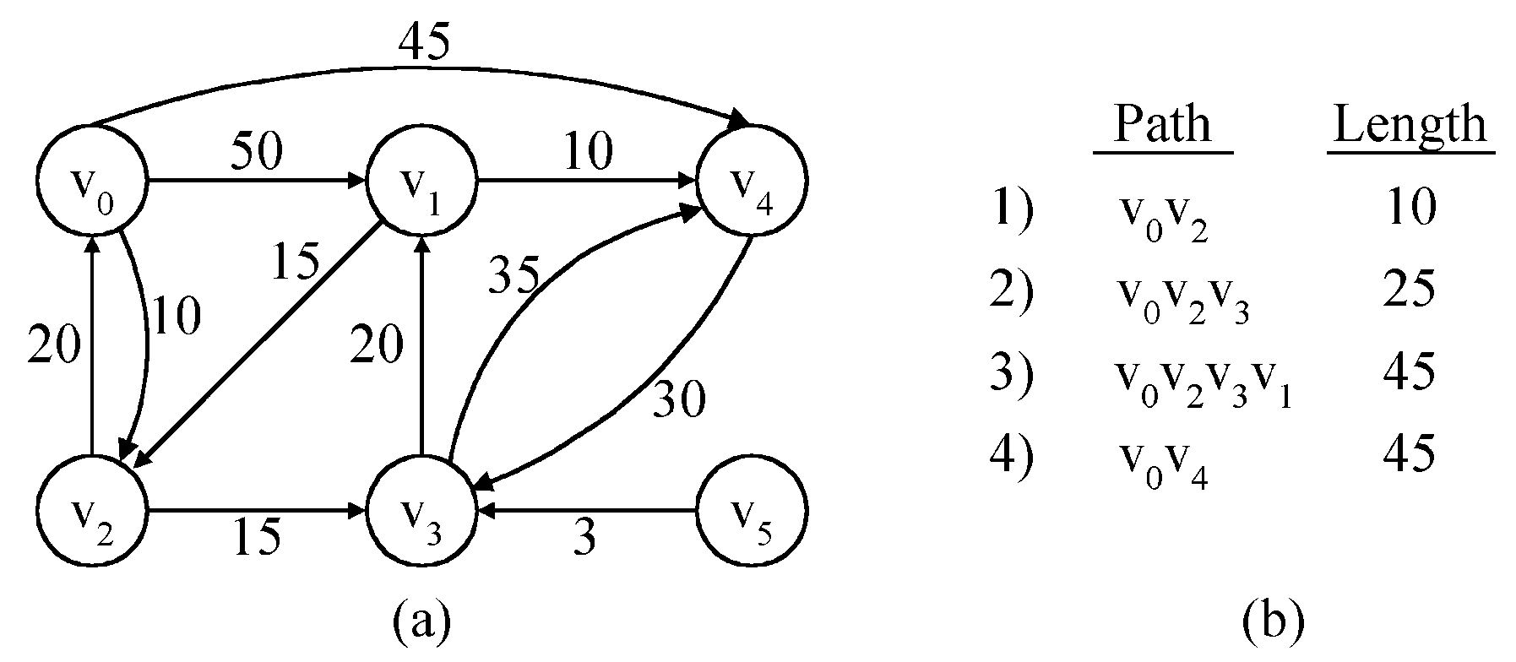
The Single-Source Shortest path Problem ( SSSP)
Given a positively weighted directed graph G with a source vertex ₁, find the shortest paths from V1 to all other vertices in the graph.
v
V₁
V₂
V₅
V₁V₃
V₁V₃V₄
V₁V₃V₄V₂
V₃
V₄
V₆
V₁V₅
5) V₁V₃V₄V₆ 28

Slide 3
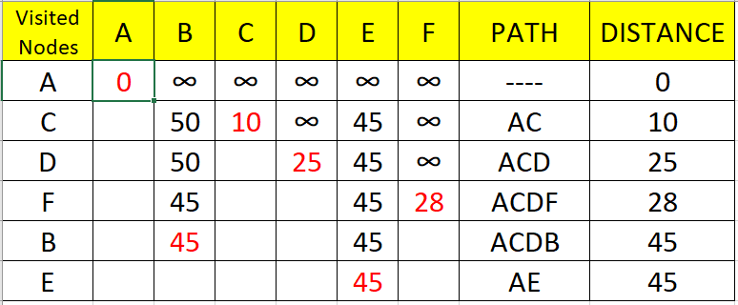
45
45
50
2
10
5
2
✓
5
1
1
✓
15
35
10
20
20
30
10
20
3
15
4
3
6
3
15
4
3
6
✓
✓
✓

Slide 4
SSSP-Dijkstra’s algorithm
Dijkstra’s algorithm assumes that cost(e)≥0 for each e in the graph.
Maintains a set S of vertices whose SP from v ( source) has been determined.
a) Select the next minimum distance node u, which is not in S.
b) for each node w adjacent to u do
  if( dist[w]>dist[u]+cost[u,w]) ) then
dist[w]:=dist[u]+cost[u,w];
Repeat step (a) and (b) until S=n (number of vertices).

Slide 5
Greedy algorithm to generate shortest paths
1.Algorithm ShortestPaths(v, cost, dist, n)
2.//dist[j], 1≤ j≤ n, is set to the length of the shortest path
3. //from vertex v to
4.// vertex j in a digraph G with n vertices. dist[v] is set to zero.
5.// G is represented by its cost adjacency matrix cost[1:n, 1:n].
6. {
for i := 1 to n do
{ // Initialize S.
s[i] := false; dist[i] := cost[v,i]
}
s[v] := true; dist[v] := 0.0 ;

Slide 6
12. for num: = 2 to n do
13. {
14. // Determine n-1 paths from v.
15. Choose u from among those vertices not in S
16. such that dist[u] is minimum;
17. s[u] := true; // Put u in S.
18. for ( each w adjacent to u with S[w]= false) do
19. // Update distance
20. if( dist[w] > dist[u] + cost[u, w]) ) then
21.dist[w] := dist[u] + cost[u, w];
22. }
23. }

Slide 7
Time complexity of Dijkstra’s Algorithm
The for loop of line 7 takes o(n).
The for loop of line 12 takes o(n).
  Each execution of this loop requires o(n) time at lines 15 and 18.
  So the total time for this loop is o(n²).
Therefore, total time taken by this algorithm is o(n²).

Slide 8
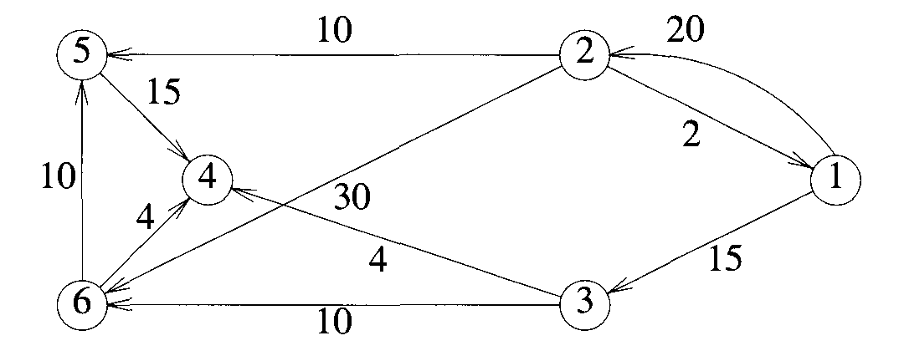
Example:
Use shortest path algorithm to obtain in nondecreasing order of the lengths of the shortest paths from vertex 1 to all remaining vertices.

Slide 9
Thank You

